Slide 1

MINI PROJECT 1
PROJECT TITLE : PREDICTING HUMAN READING BEHAVIOR
PROJECT SUPERVISOR : DR. SUNIL SAUMYA
GROUP MEMBERS : SUMITH SAI BUDDE , 18BCS101
SYED SUFYAN AHMED , 18BCS103
MP BHARATH , 18BCS057
P. CHANDAN , 18BCS063

Slide 2

OBJECTIVE:
Predicting human reading behaviour, that is eye tracking-based metrics recorded during english sentence processing during normal reading.

Slide 3
WHY PREDICT HUMAN READING BEHAVIOUR ?
• The ability of accurately modeling eye-tracking features is crucial to advance the understanding of language processing.
• Eye tracking provides millisecond-accurate records on where humans look when they are reading, shedding lights on where humans pay attention during their reading and comprehension phase.
• The benefits of utilizing eye movement data have been noticed in various domains, including natural language processing and computer vision.

Slide 4
Applications
•Key Words – to know the words on which reader is stressing more while reading
• In News Papers – to make inferences on framing headlines so as to capture reader attention.
• On Websites - to understand where the reader is focusing more on a webpage and suggest articles based on that.
• Normal Reading and Task-Specific Reading variations.
• Language Understanding.
• Neuroscience Research.

Slide 5
Applications
By analyzing eye movements during reading, we can quantify the reader’s actions and model for reading. Eye tracking helps researchers to determine where and how many times subjects focus on a certain word, along with their eye movement sequences from one word to another.
This type of eye tracking data has recently been leveraged for uses in natural language processing: it can improve performance on a variety of downstream tasks, such as part-of-speech tagging (Barrett et al., 2016), dependency parsing (Strzyz et al., 2019), and for cognitively-inspired evaluation methods for word embeddings (Søgaard, 2016) etc.

Slide 6
Challenges
Reading is complex cognitive behavior and the underlying cognitive process occurs only in the brain. Modeling such behavior requires obtaining some explicit indicators via methods such as eye tracking.
Although these eye movement models typically have parameters that are fit to empirical data, their predictions are tested on unseen data. Moreover, their predictions are usually averaged over a group of readers, while eye movement patterns vary significantly between individuals. Predicting the actual eye movements that an individual will make while reading a new text is arguably a challenging problem.

Slide 7
Eye Features to be predicted :
Number of Fixations (nFix)
First Fixation Duration (FFD)
Total Reading Time (TRT)
Go-Past Time (GPT)
Fixation Proportion (fixprop)

Slide 8
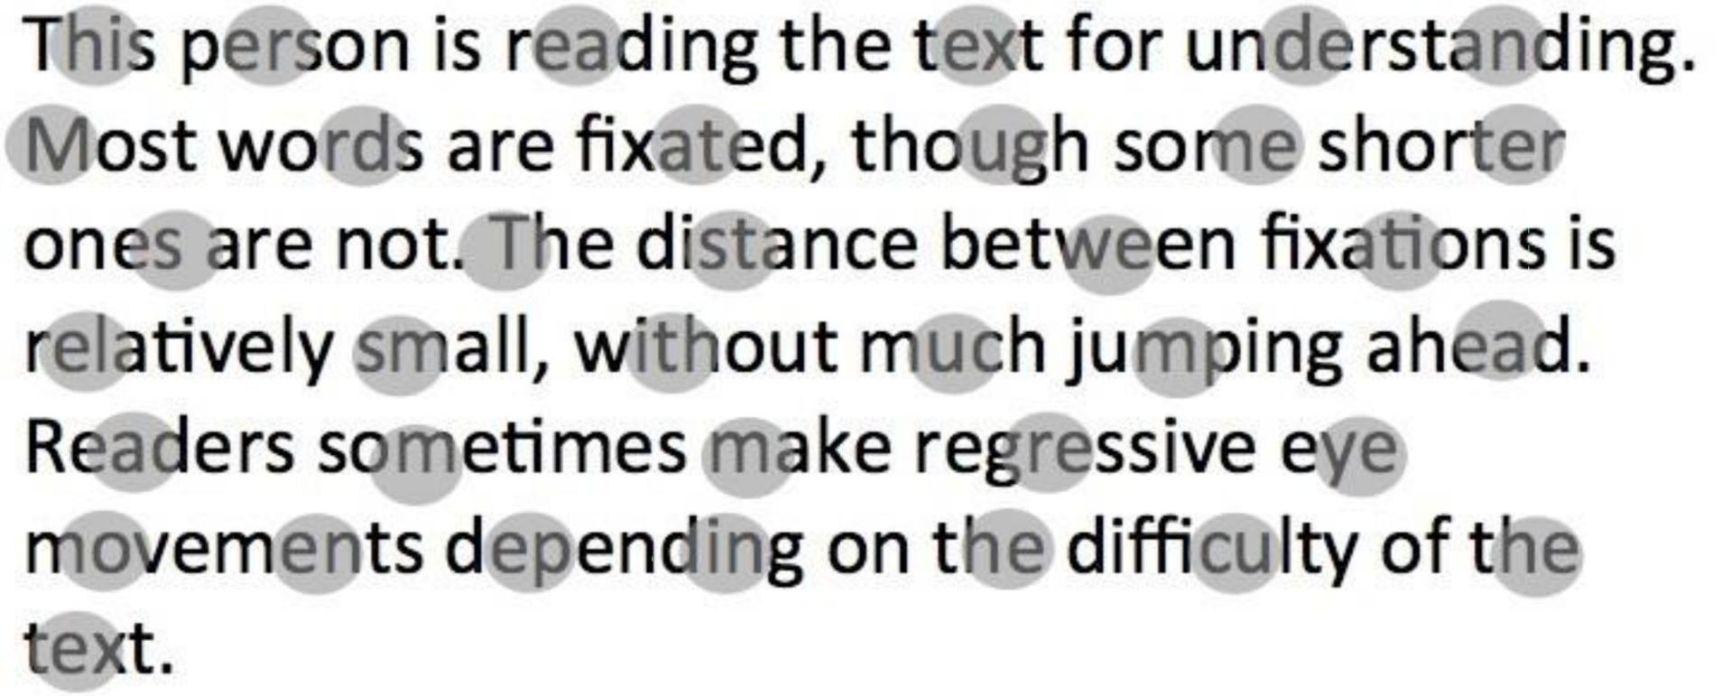
Eye Features to be predicted :
•
No of Fixations (nFix) :
Total Number of Fixations on a word.
Fixation : Refers to a point where your eyes take rest during the reading process. So visual fixation is the maintaining of visual attention on a single point(word here).
• First Fixation Duration(FFD):
First Fixation duration provides data about how long the first fixation lasted for on a particular word.

Slide 9
Eye Features to be predicted :
• Total Reading Time (TRT):
Sum of all fixation durations on the current word.
• Go-Past Time (GPT):
The amount of time from when a reader first fixates a region to when they first leave that region progressing to the right while reading.
• Fixation Proportion (fixProp) :
Proportion of readers who fixated the current word.

Slide 10
DATA SET DESCRIPTION :
• We are using the eye-tracking data of the Zurich Cognitive Language Processing Corpus (ZuCo 1.0 and ZuCo 2.0) recorded during normal reading.
• The training data will contain 800 sentences and the test set 191 sentences.
• The data provided will contain scaled features in the range between 0 and 100 to facilitate evaluation via the mean absolute error (MAE).
• The feature values are averaged over all readers.

Slide 11
DATA SET DESCRIPTION :
A prominent feature of this dataset is the personal reading speed. The sentences were presented to the subjects in a naturalistic reading scenario, where the complete sentence is presented on the screen and the subjects read each sentence at their own speed, i.e. the reader determines him/herself for how long each word is fixated and which word to fixate next.
For a detailed description of the dataset please refer to the original publications (Hollenstein et al., 2018 and Hollenstein et al., 2020).

Slide 12
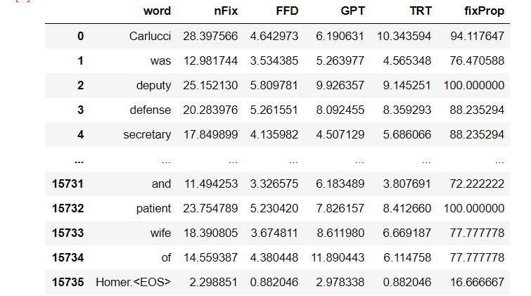
DATA SET DESCRIPTION :

Slide 13
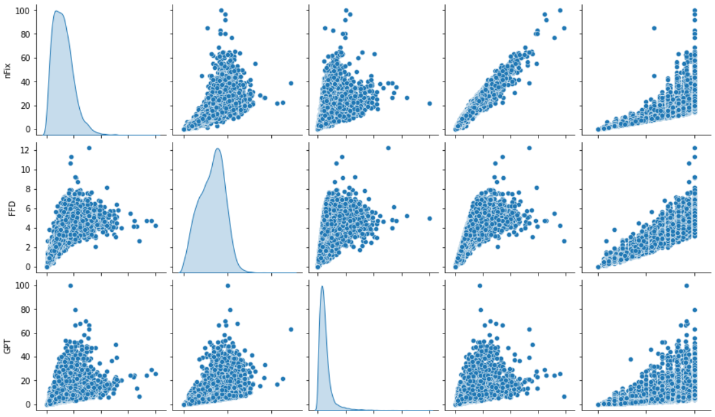
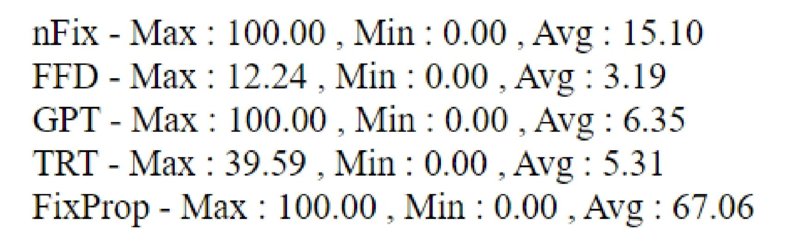
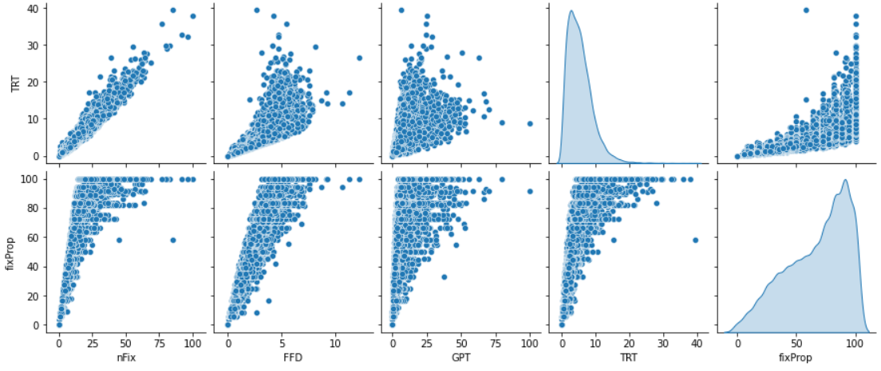
Pair wise Plots of Features

Slide 14
Conventional machine learning models

Slide 15
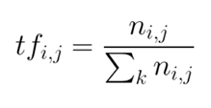
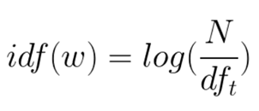
Data Preprocessing for Conventional ML models :
We are using an encoding technique called TF-IDF(Term Frequency - Inverse Data Frequency) encoding for giving input to the model.
Term Frequency: Is the occurrence of the current word in the current sentence w.r.t the total number of words in the current sentence.
Inverse Data Frequency: Log of Total number of words in the whole data corpus w.r.t the total number of sentences containing the current word.

Slide 16
Data Preprocessing for Conventional ML models :
Example :
5 sentences : [“this is good phone” , “this is bad mobile” , “she is good cat” , “he has bad temper” , “this mobile phone is not good”]
Data Corpus: [ “bad” , “cat” , “good” , “has” , “he” , “is” , “mobile” , “not” , “phone” , “she” , “temper” , “this”]
TF(“this”) : Number of “this” word in sentence1 / total number of words in sentence1
IDF(“this”) : log(total number of words in the whole data corpus / total number of sentences having “this” word)
TF : 1 / 4 = 0.25 , IDF : loge(12 / 3) = 1.38629
TF-IDF = 0.25*1.38629 = 0.3465725

Slide 17
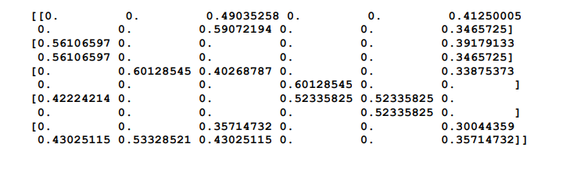
Data Preprocessing for Conventional ML models :
We are converting a collection of raw documents to a matrix of TF-IDF features using a function called TfidfVectorizer() as shown below :

Slide 18
Conventional Model Description and flowchart:
Linear Regression :
Linear regression attempts to model the relationship between two variables by fitting a linear equation to observed data. One variable is considered to be an explanatory variable, and the other is considered to be a dependent variable.
A linear regression line has an equation of the form Y = a + bX, where X is the explanatory variable and Y is the dependent variable. The slope of the line is b and a is the intercept.

Slide 19
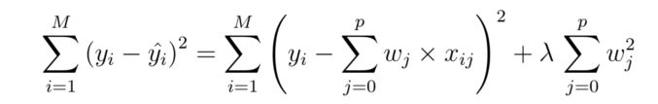
Conventional Model Description and flowchart:
Ridge Regression :
Ridge regression is a method of estimating the coefficients of multiple-regression models in scenarios where independent variables are highly correlated.
By adding a degree of bias to the regression estimates, ridge regression reduces the standard errors. It is hoped that the net effect will be to give estimates that are more reliable.
Cost Function :
Lambda is the penalty term. λ given here is denoted by an alpha parameter in the ridge function. So, by changing the values of alpha, we are controlling the penalty term.

Slide 20
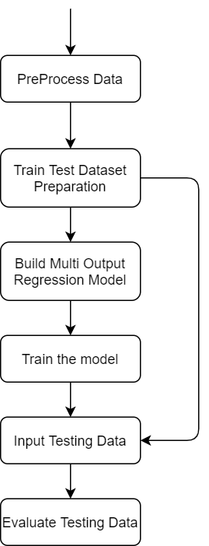
Conventional Model Description and flowchart:

Slide 21
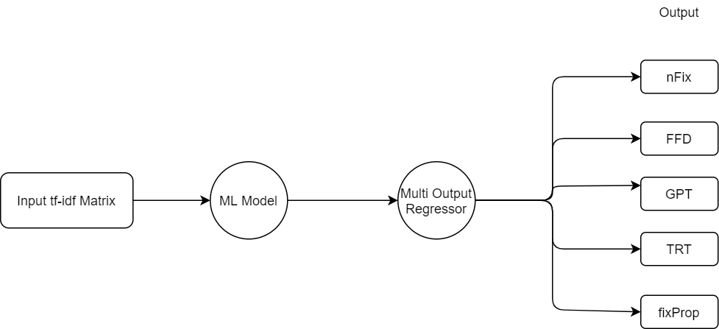
Conventional Model Description and flowchart:
Input-Output pairs
We feed the Tfidf matrix in compressed row format as the input to our model and pass the parameters to train our model on the data along with word features. We use a multi output regressor model and predict all the features at once.

Slide 22
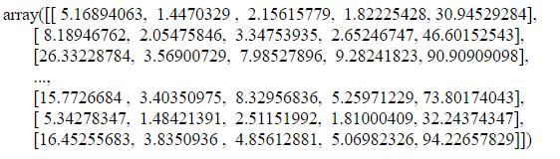
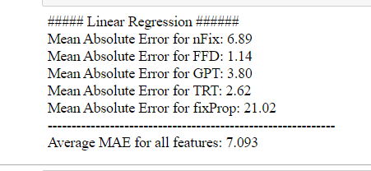
Results of linear Regression model :
By passing the TF-IDF vectorized input to the model and predicting all the features at a time using the multi-output regression model,
Output :
Predicted features : MAE :

Slide 23
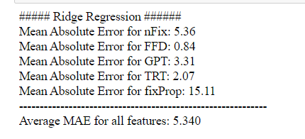
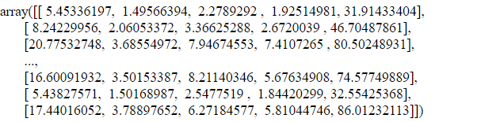
Results of Ridge Regression model :
By passing the TF-IDF vectorized input to the model and predicting all the features at a time using the multi-output regression model,
Parameters : Alpha = 2.54
Output :
Predicted Features : MAE :

Slide 24
DEEP learning models

Slide 25
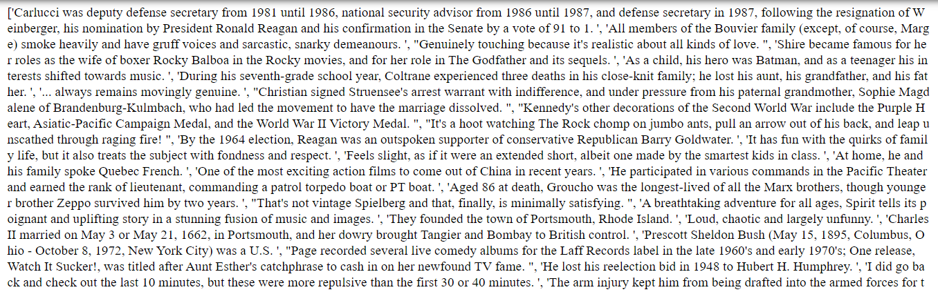
Data Preprocessing for Deep Learning models :
a. Cleaning and Forming Sentences:
The data is given in the form of words and some words have <EOS> tags in them for marking sentence endings. Hence we use those tags to know sentence endings and concatenate only the words by removing <EOS> tags to form sentences.

Slide 26
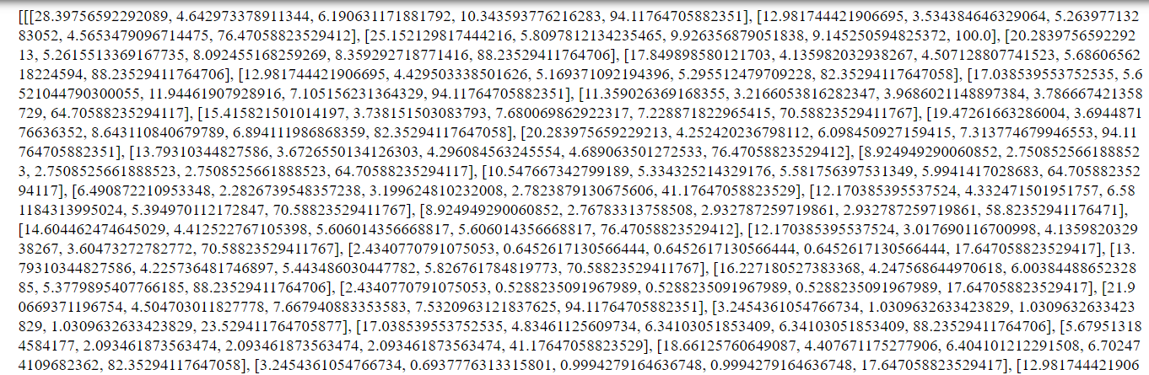
Data Preprocessing for Deep Learning models :
b. Make a list of List Features:
We make a list of list features for each word and then append that to a list so as to have a list of sentence features.

Slide 27
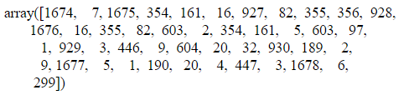
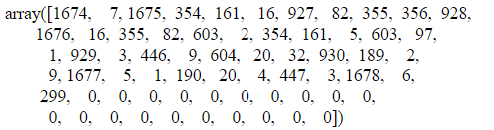
Data Preprocessing for Deep Learning models :
c. Text to Sequences(Encoding):
We cannot feed raw text directly into deep learning models. Text data must be encoded as numbers to be used as input or output for machine learning and deep learning models. Hence we have converted text to sequences.
Sequence of sentence 1 :
d. Padding :
Padding is used to ensure that all sequences in a list have the same length. By default this is done by padding 0 in the end of each sequence until each sequence has the same length as the longest sequence.
The list of features is also padded in the same way.
Padded Sequence for sentence 1 :

Slide 28
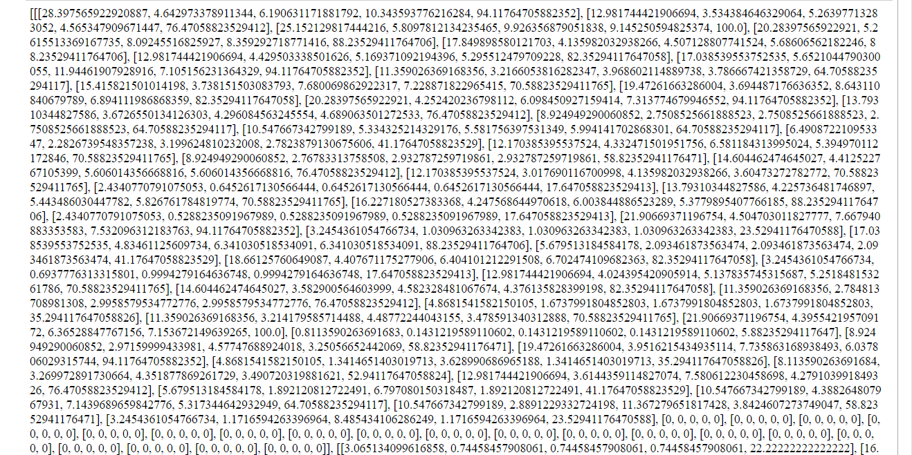
Data Preprocessing for Deep Learning models :
Padded features for sentence 1 :

Slide 29
Deep Learning Models : lstm & BiLSTM

Slide 30
LSTM model and its architecture:
Long Short-Term Memory is an advanced version of recurrent neural network (RNN) architecture that was designed to model chronological sequences and their long-range dependencies more precisely than conventional RNNs.
LSTMs provide us with a large range of parameters such as learning rates, and input and output biases.
LSTMs comprises of three logistic sigmoid gates and one tanh layer. Gates have been introduced in order to limit the information that is passed through the cell. They determine which part of the information will be needed by the next cell and which part is to be discarded.

Slide 31
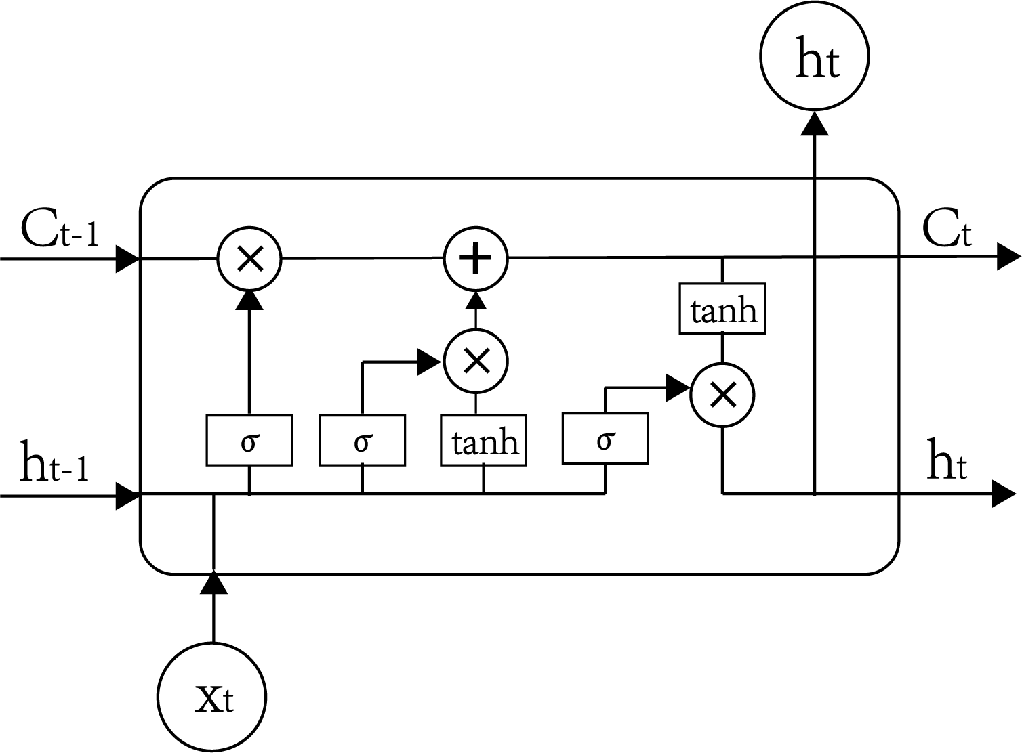
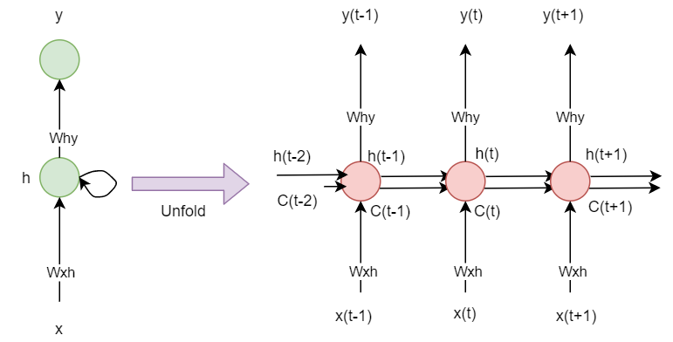
LSTM model and its architecture:
LSTM Hidden Layer LSTM cell

Slide 32
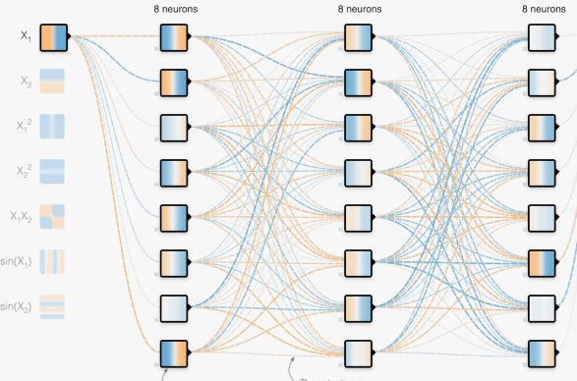
LSTM model and its architecture:
Embedding Layer :
Word embeddings is a way to represent words by creating high dimensional vector space in which similar words are close to each other. It enables us to convert each word into a fixed length vector of defined size. The resultant vector is a dense one with having real values instead of just 0's and 1's. The fixed length of word vectors helps us to represent words in a better way along with reduced dimensions.
Dense Layer : The dense layer is a fully connected layer, meaning all the neurons in a layer are connected to those in the next layer.

Slide 33
LSTM model and its flowchart:
Model Layers :
Input Layer
Embedding Layer
LSTM Layer
Dropout Layer
Time Distributed Layer
Output Layer

Slide 34
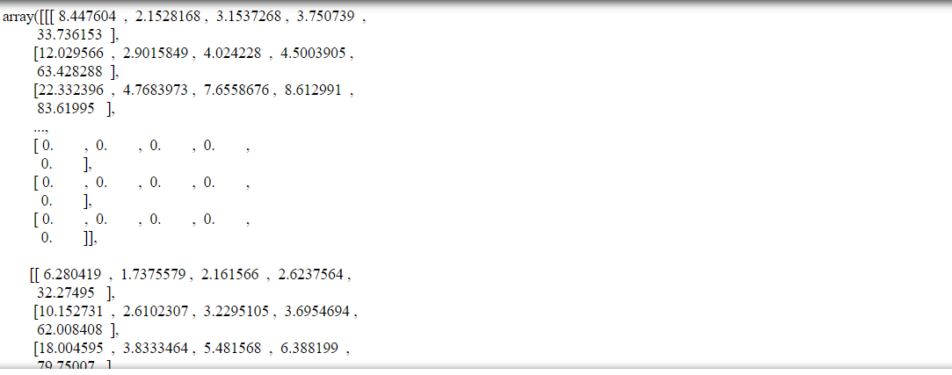
OUTPUT & Results of LSTM model :
Predicted Values of Features :

Slide 35
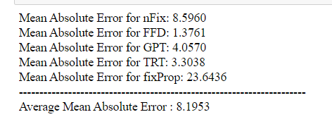
OUTPUT & Results of LSTM model :
As the output data will also be padded to the length of longest sentence, we have to process the output and remove the padded length or else our error would be biased.
The actual error is calculated using the function act_error() by removing the padded length from output and then calculating the MAE.
MAE for all features :

Slide 36
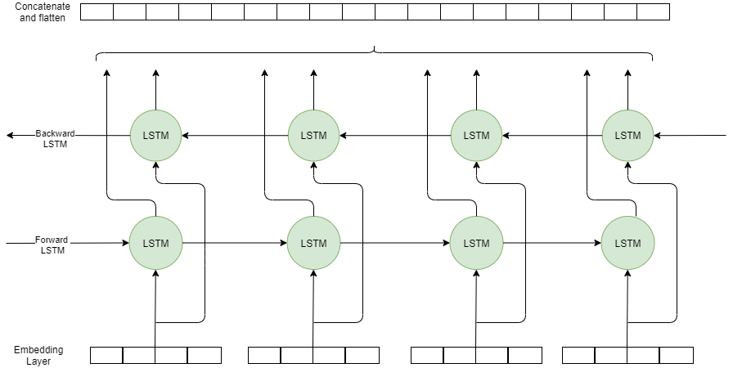
BiLSTM model and its architecture:
A Bidirectional LSTM, or BiLSTM, is a sequence processing model that consists of two LSTMs: one taking the input in a forward direction, and the other in a backwards direction. The first on the input sequence as-is and the second on a reversed copy of the input sequence. This can provide additional context to the network and result in faster and even fuller learning on the problem.
BiLSTM Architecture

Slide 37

LSTM & BiLSTM model and its architecture:
Input - Output pairs :

Slide 38
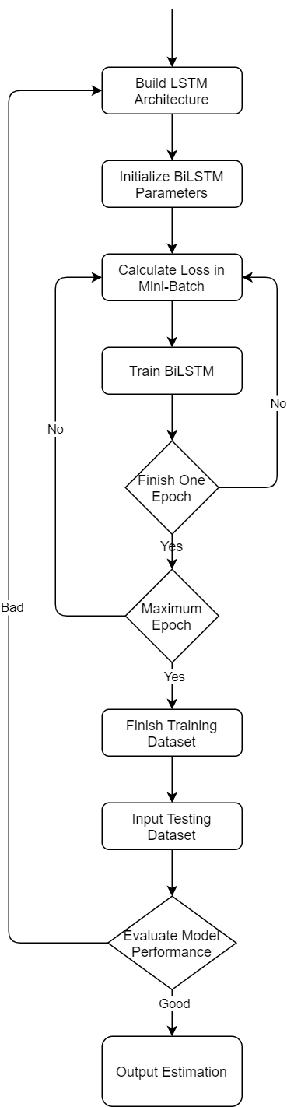
BiLSTM model and its flowchart:
Model Layers :
Input Layer
Embedding Layer
BiLSTM Layer 1
BiLSTM Layer 2
Dropout Layer
Time Distributed Layer
Output Layer

Slide 39
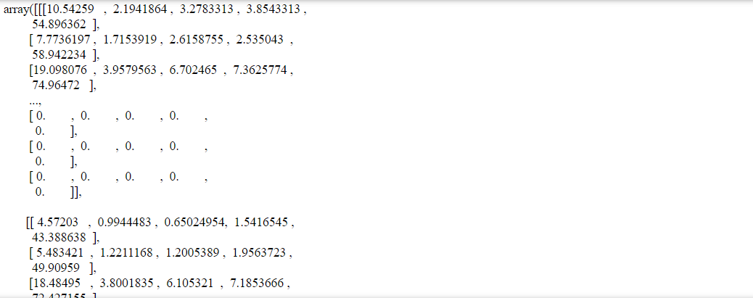
OUTPUT & Results of BiLSTM model :
Pass the preprocessed Input to the BiLSTM model and train the model.
Predicted Values of Features :

Slide 40
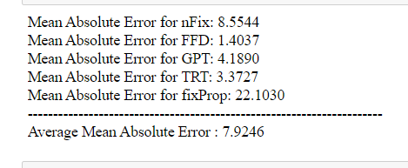
OUTPUT & Results of BiLSTM model :
As the output data will also be padded to the length of longest sentence, we have to process the output and remove the padded length or else our error would be biased.
The actual error is calculated using the function act_error() by removing the padded length from output and then calculating the MAE.
MAE for all features :

Slide 41
Deep Learning Model : RoBERTa

Slide 42
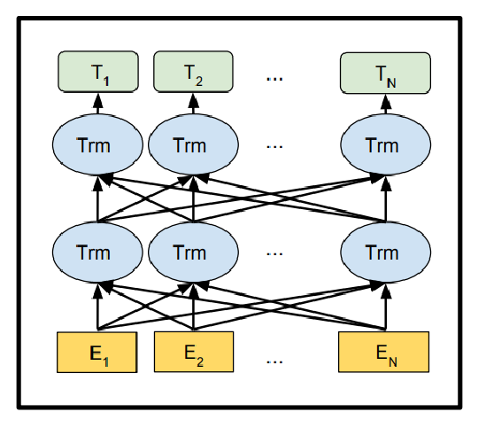
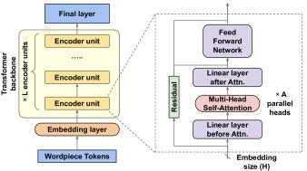
RoBERTa(Robustly Optimized BERT Pre-Training Approach)Model :
It is a robustly optimized method for pretraining natural language processing (NLP) systems that improves on Bidirectional Encoder Representations from Transformers(BERT). RoBERTa has the similar architecture as of BERT.
RoBERTa model builds on BERT and modifies key hyperparameters, removing the next-sentence pretraining objective and training with much larger mini-batches and learning rates.
L = 12

Slide 43
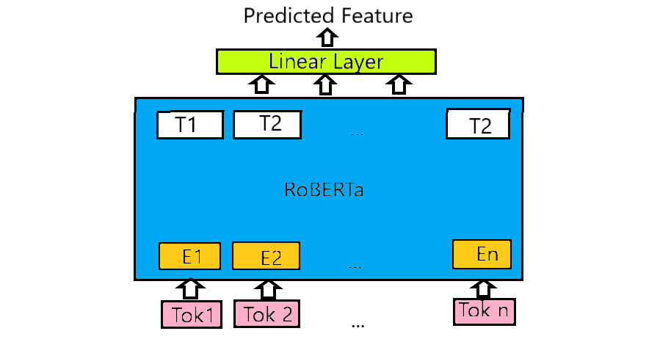
RoBERTa(Robustly Optimized BERT Pre-Training Approach)Model :
A word starts with its embedding representation from the embedding layer.Every layer does some multi-headed attention computation on the word representation of the previous layer to create a new intermediate representation. E1 is the embedding representation, T1 is the final output and Trm are the intermediate representations of the same token.
In a 12-layers RoBERTa model a token will have 12 intermediate representations as there will be 12 encoding layers.
Our model consists of RoBERTa with a regression head on each token, which is a linear layer that predicts each output feature from the last layer’s embeddings one at a time.The model is initialized from pretrained weights and fine-tuned on the task data.

Slide 44
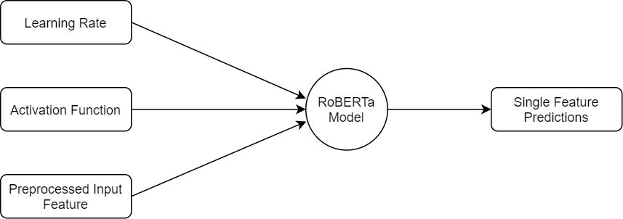
RoBERTa(Robustly Optimized BERT Pre-Training Approach)Model :
Input - Output pairs :
We pass the preprocessed text input and the feature to be predicted to our model. We train the model on that feature and predict the features for test data. The model outputs one feature at a time.

Slide 45
RoBERTa(Robustly Optimized BERT Pre-Training Approach)Model :
Input
Embedding Layer
Pre-trained RoBERTa Model
:
Encoding unit 1
Dropout Layer 1
Encoding unit 12
Dense Layer
Linear Layer
Activation Layer
Dropout Layer 2
Output Layer

Slide 46
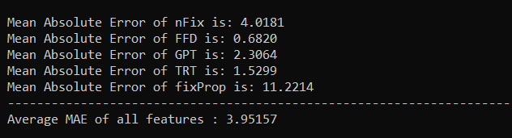
Results of RoBERTa Model :
Passing the preprocessed input to the roberta model along with word lengths, word id’s and using the following parameter values results are as follows:
Number of epochs : 32 Learning rate : 5e-05 Activation : relu
MAE for all features :

Slide 47
Comparison and conclusion

Slide 48

Comparison of Models :
Performance Metrics :
The mean absolute error (MAE) is the simplest regression error metric to understand. We’ll calculate the residual for every data point, taking only the absolute value of each so that negative and positive residuals do not cancel out. We then take the average of all these residuals. Effectively, MAE describes the typical magnitude of the residuals.
Where
y_{i} is the predicted value,
x_{i} is the true value,
n is the total number of samples.
The best model is the one with least Average MAE over all features.

Slide 49
Comparison of Models :
S.No |  |  |  | Model
 |  | Linear Regr | Ridge Regr | LSTM | BiLSTM | RoBERTa
1 | MAE nFix | 6.89 | 5.36 | 8.5960 | 8.5544 | 4.0181
2 | MAE FFD | 1.14 | 0.84 | 1.3761 | 1.4037 | 0.6820
3 | MAE GPT | 3.80 | 3.31 | 4.0570 | 4.1890 | 2.3064
4 | MAE TRT | 2.62 | 2.07 | 3.3038 | 3.3727 | 1.5299
5 | MAE fixProp | 21.02 | 15.11 | 23.6436 | 22.1030 | 11.2214
6 | Average MAE | 7.093 | 5.340 | 8.1953 | 7.92456 | 3.95157
7 | Training Time | 5 mins | 5 mins | 45 Mins | 1 hour | 2 hours (for each feature)

Slide 50
Comparison of Models :
Among the 5 models, Ridge and Linear Regression are the fastest but gives average results. Ridge model outperforms Linear model because of the bias/penalty term that it adds to the regression estimates. LSTM and BiLSTM models give almost similar results and they take good amount of time to train but they give high actual mae among all the models.
RoBERTa model is the slowest as it takes 2 hours to train the model for 32 epochs on a single feature but it gives the best predictions and results. The RoBERTa model gives best results i.e, the least mae because the input passes through 12 encoding layers and as the model was pre trained on a relatively large standard text dataset, the number of steps for the output to converge reduces and also efficiency increases.

Slide 51
CONCLUSION
In this project we propose a simple approach to predict eye tracking features using different types of models and compared their results .
In comparison with conventional eye movement models, the new approach was shown to achieve good accuracy in predicting a user’s fixation features during reading.
From all the models we explored, RoBERTa gives the least Mean Absolute Error. As our task is a regression problem, loss matters the most but the model takes a lot of time in training. If the model is to be used for real world applications like Autism detection,Partial Vision etc then the model with least amount of loss would be most preferable even though it takes much time to train because errors should be the least in medical applications.. But if you have a task with a time constraint then you can go with Ridge Regression model as it is the second best in terms of MAE and also the fastest.

Slide 52
References
Nora Hollenstein, Emmanuele Chersoni, Cassandra Jacobs, Yohei Oseki, Laurent Prévot, and Enrico Santus. 2021. CMCL 2021 shared task on eye-tracking prediction. In Proceedings of the Workshop on Cognitive Modeling and Computational Linguistics.
Yinhan Liu, Myle Ott, Naman Goyal, Jingfei Du, Mandar Joshi, Danqi Chen, Omer Levy, Mike Lewis, Luke Zettlemoyer, and Veselin Stoyanov. 2019. RoBERTa: A robustly optimized BERT pretraining approach. arXiv preprint arXiv:1907.11692.
Jacob Devlin, Ming-Wei Chang, Kenton Lee, and Kristina Toutanova. 2019. BERT: Pretraining of deep bidirectional transformers for language understanding. In Proceedings of the 2019 Conference of the North American Chapter of the Association for Computational Linguistics: Human Language Technologies, Volume 1 (Long and Short Papers), pages 4171–4186.

Slide 53
THANK YOU

